Slide 1

BLOG PUBLISHING APPLICATION
KAVYA BIJU
22PMC134

Slide 2

ABSTRACT
The Blog Publishing Application is a web-based platform built using Django, Python, and MySQL that enables users to read and publish blog articles.
The application provides an interactive and engaging environment for users to explore a wide range of blog content and contribute their own thoughts and ideas through blog writing.
The blog publishing application represents a significant advancement in simplifying and enhancing the blogging experience.
It offers a comprehensive suite of features designed to empower bloggers to create, manage, and publish captivating content effortlessly.

Slide 3



REQUIREMENTS
User Registration and Authentication:
User registration functionality allowing individuals to create accounts.
Authentication mechanisms to ensure secure access and protect user data.
Blog Management:
Ability to create and manage multiple blogs within a single account.
Search Functionality:
Advanced search capabilities for users to find specific blog posts based on keywords.

Slide 4
FEATURES AND HIGHLIGHTS
Add View Blog
Users can create and publish and view their own blog posts on the platform.
Blog Publish
Admins have the authority to publish blogs submitted by users.
Update and Delete Blog
Users can edit or remove their published blogs but once the admin published the blog user can’t update the blog
Read Blog
Users can read and explore the published blogs on the platform.
Save to Draft
Users can save their blog posts as drafts for future editing and publishing.

Slide 5
FEATURES AND HIGHLIGHTS
View Draft
Users can view and manage their saved blog drafts. When the user publish the blog it will automatically remove from view draft page to view blog page.
View Admin Message
Admins can send messages to users, which users can view.
Search Blog
Users can search for specific blogs titles.
Edit Profile
Users can edit and update their profile information on the platform.
Blog Count
The platform tracks and displays the total number of published blogs of specific user
Rate the Blog
Users can rate and view the rating.

Slide 6
TECHICAL ASPECTS
Development Framework: Django (Python web framework) will be used for building the project.
Database: MySQL will be used as the database management system to store blog posts, user information, drafts, etc.
Admin Panel: Django's admin panel will be customized to handle blog publishing, user management, and message administration , rating, draft etc.
Templates: HTML templates will be created to render the user interface and display the blog content, drafts, profile information, etc.
Styling: JavaScript, CSS and/or front-end frameworks like Bootstrap can be used for styling and responsive design.

Slide 7
ARCHITECTURE
Django Rest Framework
If you plan to build a RESTful API for your project, this library can help in creating APIs for blog management, user authentication, etc.
Models
Define Django models to represent the database schema and manage data persistence. Models represent entities such as blogs, drafts, users, and ratings.
RESTful APIs
Design and develop RESTful APIs using Django's built-in capabilities or Django REST framework. These APIs can be used for various purposes, such as fetching blog data, saving drafts, submitting ratings, and performing user authentication and authorization

Slide 8
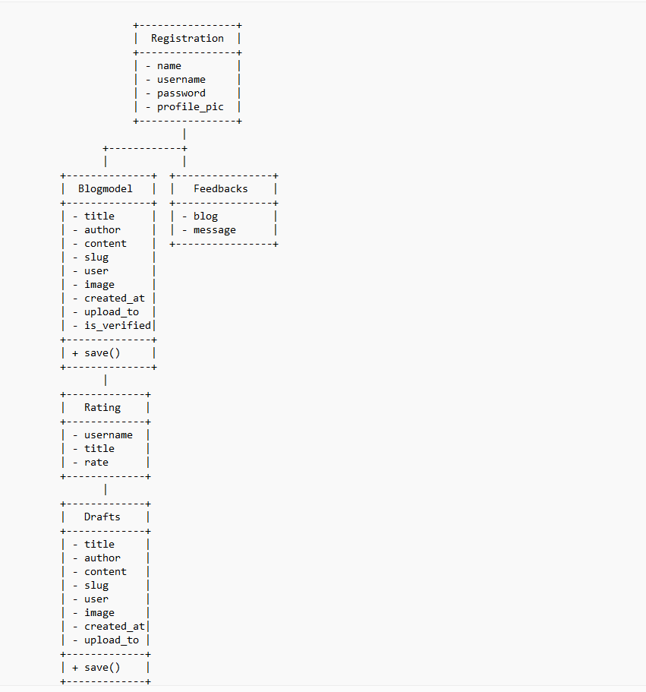
CLASS DIAGRAM

Slide 9
CHALLENGES FACED
Draft Management: Implementing a draft feature where users can save their incomplete blog posts and resume editing later can be complex. Managing draft versions, handling conflicts, and providing a seamless editing experience without losing unsaved changes can pose challenges.
Search Functionality: Implementing an efficient and accurate search functionality for blog posts can be challenging, especially when dealing with a large number of blog entries. Integrating a search engine or utilizing Django's full-text search capabilities requires proper indexing, relevance ranking, and handling search queries efficiently.
Database Design and Performance: Designing an efficient database schema and optimizing database queries can be challenging, especially as your application scales and handles a large number of users and blog posts. Ensuring data integrity, establishing proper indexing, and optimizing complex queries are important for maintaining good performance.

Slide 10
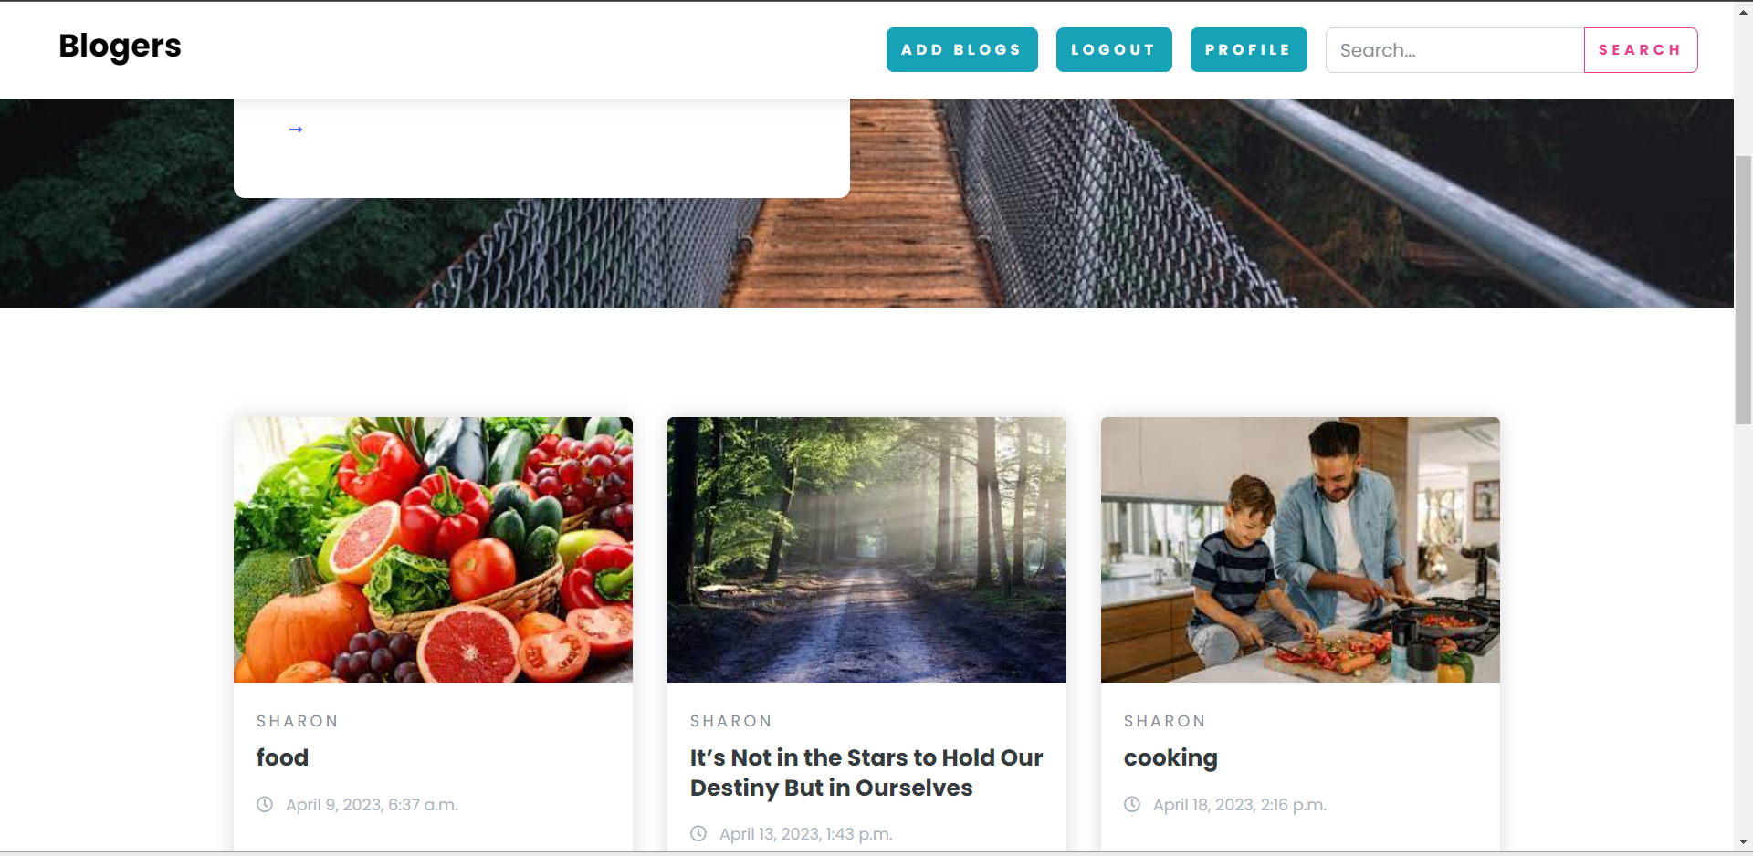
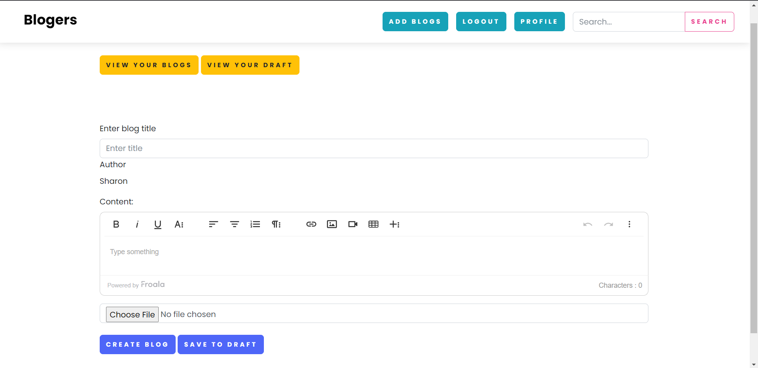
SCREENSHOTS
INDEX.HTML
ADD_BLOG.HTML

Slide 11
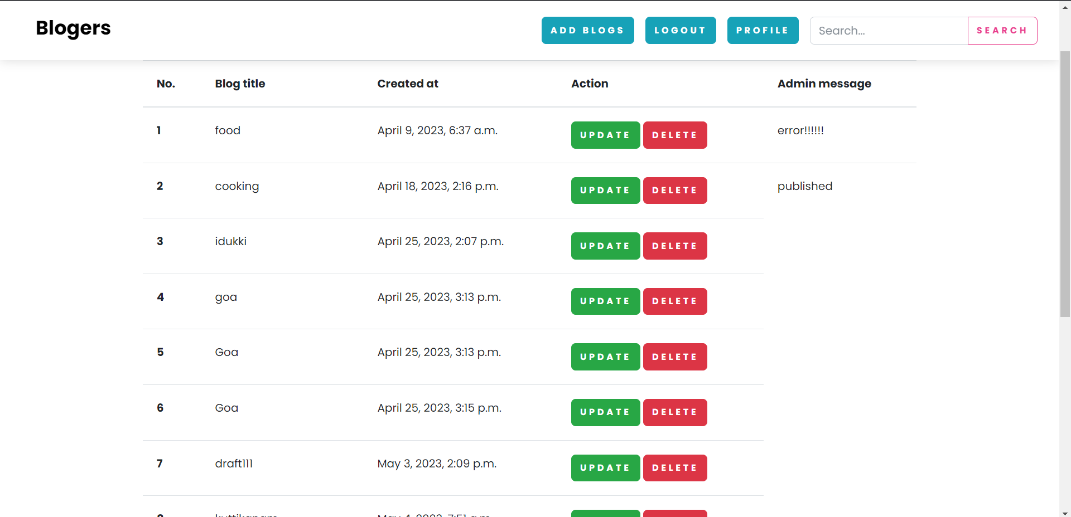
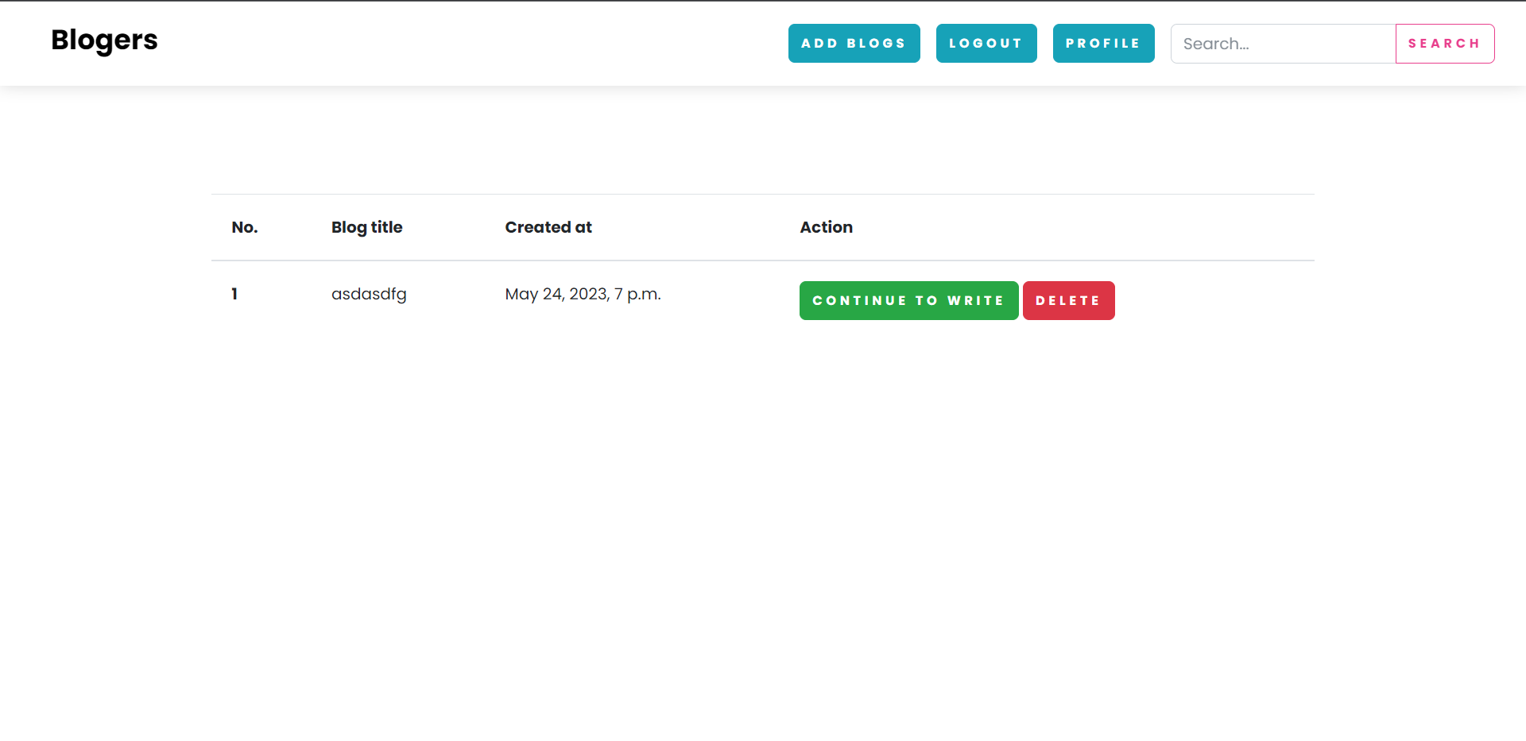
SCREENSHOTS
VIEW_BLOG.HTML
VIEW_DRAFT.HTML

Slide 12
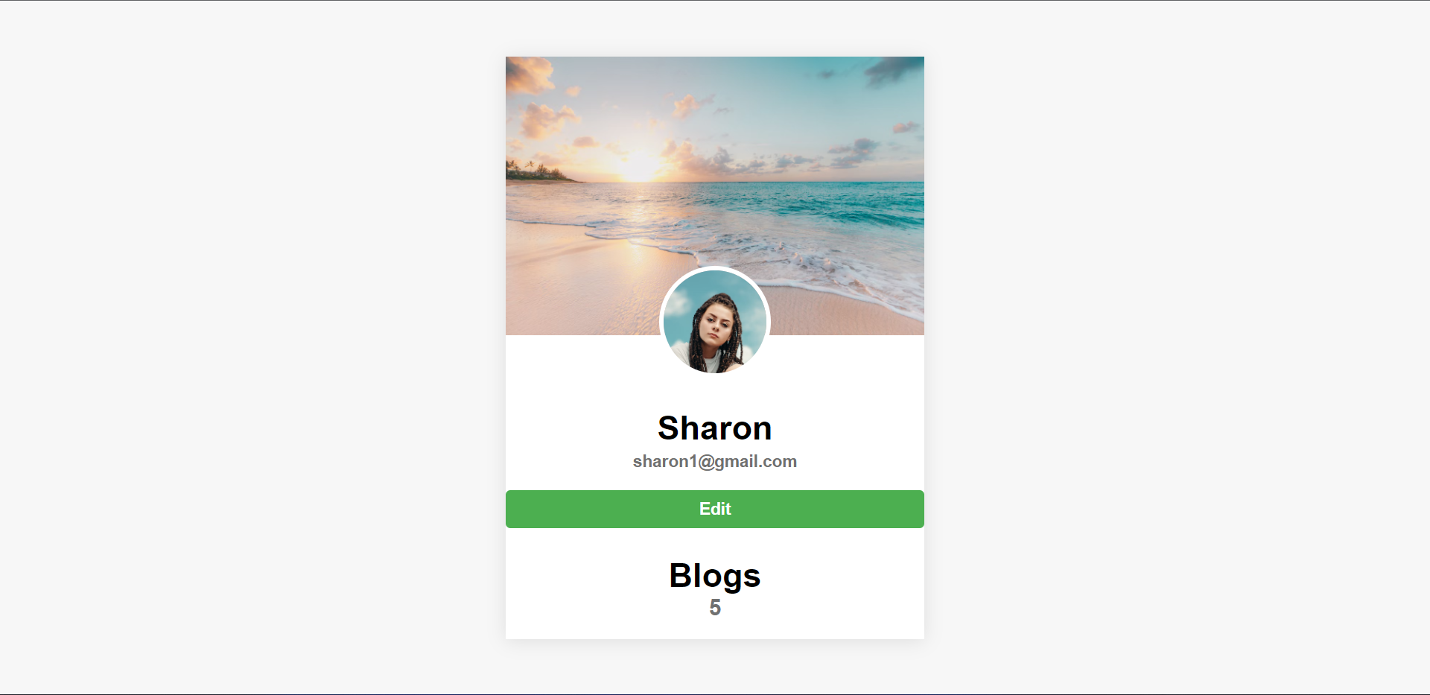
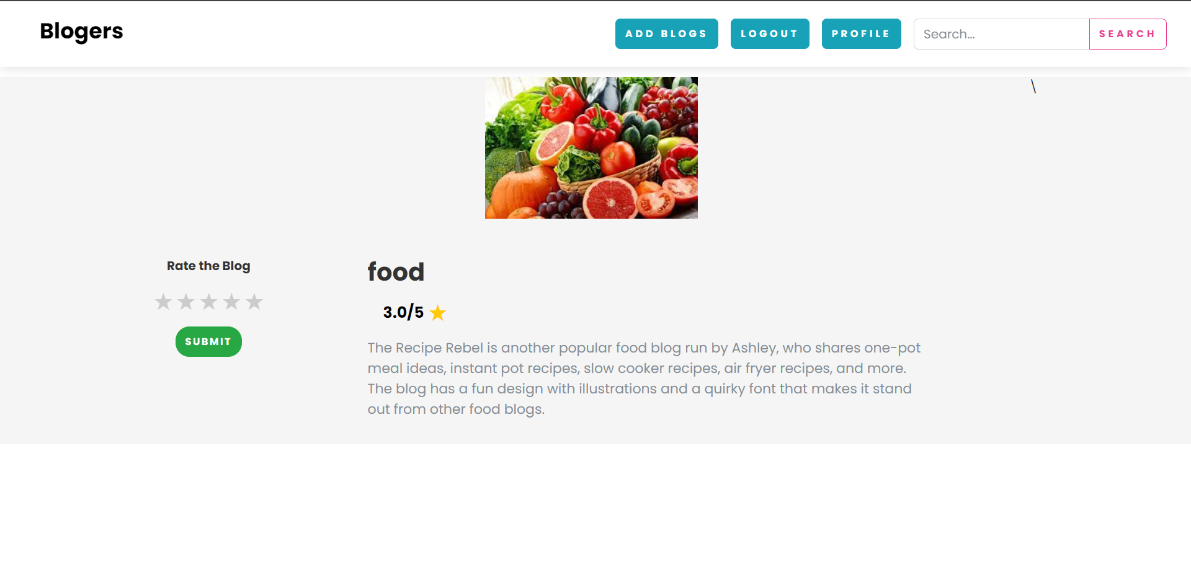
SCREENSHOTS
PROFILE.HTML
BLOG_DETAILS.HTML

Slide 13
FUTURE ENCHANCEMENT
Tagging and Categories: Implement a tagging system that allows bloggers to assign relevant tags to their blog posts. This will enable users to filter and search for blogs based on specific tags or categories of interest, improving the discoverability of content.
Social Media Integration: Integrate social media sharing functionalities, such as sharing blog posts on platforms like Facebook, Twitter, or LinkedIn. This will help increase the visibility of blog posts and attract a wider audience.
Commenting and Discussion: Add a commenting system to allow users to engage in discussions and provide feedback on blog posts. Implement features like threaded comments, comment moderation, and notification alerts to enhance the user experience.

Slide 14
CONCLUSION
In conclusion, the blog publishing application we discussed offers a range of features and functionalities to allow users to create, publish, read, and interact with blog posts.
By leveraging technologies such as Django, Python, MySQL, and various third-party libraries like jQuery, the application provides a robust and user-friendly platform for bloggers and readers.
By continuously refining and improving the application based on user feedback and industry trends, the blog publishing platform can grow into a thriving community where bloggers can share their knowledge and readers can discover engaging content.
With a solid foundation and a focus on user experience, the application has the potential to become a valuable platform for content creators and readers alike.

Slide 15
REFERENCE
https://www.slideshare.net/shahidcseku/blog-an-online-blogging-website
https://bloggerspassion.com/best-blogging-apps/

Slide 16

Thank you

